Slide 1
Chapter 6:
INTERFACES
Visit for more Learning Resources

Slide 2
RS232 (Recommended Standard) :
Is an asynchronous serial communication method
Known as EIA RS 232(Electronics Industry Association), EIA 232 and TIA 232(Telecommunication Industry Association)
DTE has a 25 pin D-type male connector and DCE has a 25 pin D-type female connector
Voltage Level of RS 232 :
Logical 1-negative level, is called marking estate, OFF
Logical 0-positive, is called space estate, ON
Circuit voltage-25 volts
Signal level of +5/-5V,+10/-10V,+12/-12V and -15/+15V

Slide 3
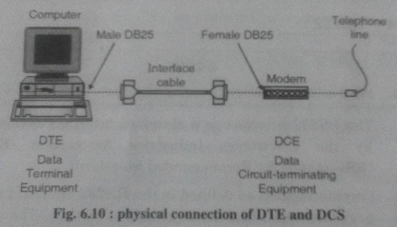

Slide 4
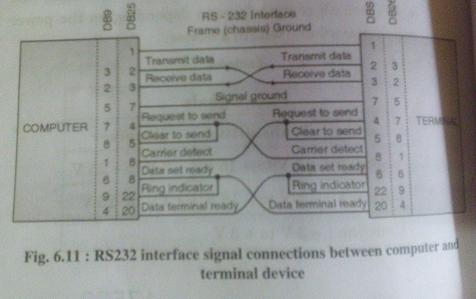
RS 232 Signal Description :

Slide 5
CD(Carrier Detect or Data Carrier Detect) : computer to know that the modem connected to the serial port has made a proper connection
RxD(Receive Data) : data send from DCE to DTE
TxD(Transmit Data) :data send from DCE to DTE
GND(Signal Ground) : return path
DSR(Data Set Ready) : from device to computer to inform that device is ready for communication
RTS(Request to Send) : computer is ready to start the data communication
CTS(Clear To Send) : inform to the computer that the computer can start the data transmission
RI(Ring Indictor) : to inform to computer that someone is calling the modem

Slide 6
Serial Port in PC (Using NULL MODEM) :
To connect two DTE(Computer, terminal, printer etc)
With a null modem connection, transmit and receive lines are crosslinked

Slide 7
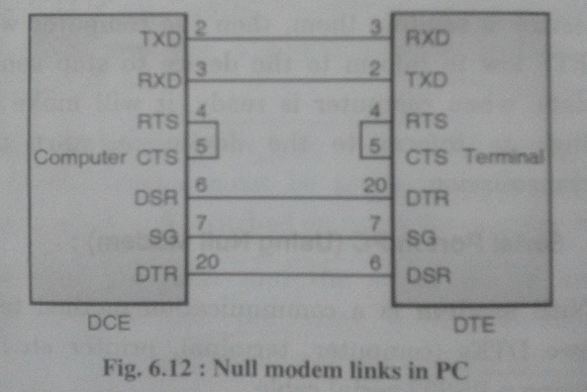

Slide 8
Firewire :
Named for IEEE 1394 High Speed Serial Bus interface
It is also known as i.Link
Used in modern PC , multimedia device such as digital Video camera
Offer high speed communication and isochronous real- time data services
Features :
Hot pluggability
Connected 63 peripherals in an acyclic topology
Peer to peer device communication
Plug and play
45watts of power per port at up to 30 volts
100,200 or 400 bits/s
Cable length- 4.5 meter
No need for device ID
Isochronous data transfer- suitable for digital video

Slide 9
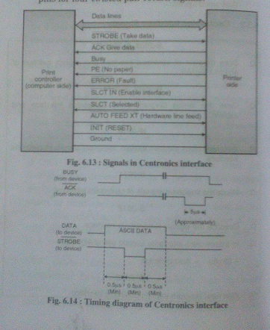
Centronics Interface Signal :
For more detail contact us

